Slide 1


Evaluating Volunteers and the
Volunteer Program
January 25, 2017

Slide 2
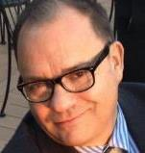
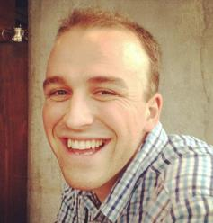
Your Hosts
Greg Stevens
Assistant Director, Professional Development
American Alliance of Museums
Arlington, VA
gstevens@aam-us.org
@DCGregStevens
Richard Harker
Education and Outreach Manager
Museum of History & Holocaust Education Kennesaw State University
Kennesaw, GA
rharker@kennesaw.edu
@rjwharker
Notes:
Greg

Slide 3
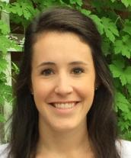
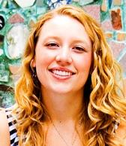
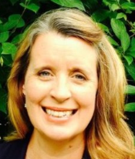
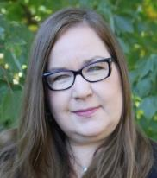
Today’s Presenters
Megan Millman,
Program Assistant, Winterthur Museum, Garden and Library
mmillm@winterthur.org
Olivia Edlund
Education and Outreach Manager
Philadelphia Magic Gardens
oedlund@phillymagicgardens.org
Tina Nolan
Principal, Tina Nolan Consulting
tina@tinanolan.com
Marne Bariso
Volunteer and Intern Manager
Chicago History Museum
Bariso@chicagohistory.org
Notes:
Greg

Slide 4
In Collaboration with
A Professional Network
of the American Alliance of Museums
Leadership and Management Network (LMN)
)
Notes:
Greg

Slide 5

In Collaboration with
www.aamv.org
Notes:
Greg

Slide 6
Watch & Talk Events
Arizona
Tempe
Halle Heart Children's Museum
Florida
Fort Lauderdale
Fort Lauderdale Historical Society
Miami
Vizcaya Museum and Gardens
Massachusetts
Newton
Historic Newton
New York
Corning
The Corning Museum of Glass
New York City
Brooklyn Botanic Garden
North Carolina
Asheville
Asheville Museum of Art
Pennsylvania
Philadelphia
Academy of Natural Sciences
Washington
Spokane
Northwest Museum of Arts and Culture
Notes:
Greg

Slide 7
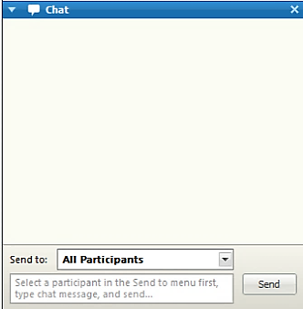
Questions or Comments
Type your message in Chat box
Select All Participants for general Qs or comments
Select Host to send a private message
Press Send
Notes:
PRESHOW Greg

Slide 8
Closed Captioning
Closed Captioning link appears in the Chat box
Notes:
PRESHOW Greg

Slide 9
Resources
Resources link appears in the Chat box
Notes:
PRESHOW Greg

Slide 10
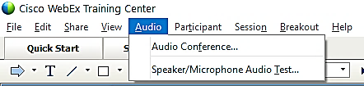
Audio Troubleshooting
Find the Audio tab at top of your screen:
Join audio via computer or telephone.
OR
Test your computer speakers.
Notes:
PRESHOW Greg

Slide 11
Need Additional Technical Help?
1. Select Host in Chat box and send a private message.
2. Call WebEx Global support team:
  1-866-229-3239 (US and Canada Toll-Free) or +1-916-636-9000 (International Toll).
    WebEx site: iCohere.Webex.com
    Meeting access number: 641 132 286 #
Notes:
PRESHOW Greg

Slide 12

Twitter
@AAMers
@MuseumVols
#AAMVolunteers
Notes:
Join us on Twitter: @AAMers
#AAMinclusion
#AAMprofdev

Slide 13

Audience Poll
How many people are watching today’s program with you?
Just me
2-3
4-6
7-10
11-15
16-20
>20
Notes:
How many people watching todays program with you?

Slide 14
Evaluating Volunteers and the
Volunteer Program
January 25, 2017

Slide 15

Your Hosts
Greg Stevens
Assistant Director, Professional Development
American Alliance of Museums
Arlington, VA
gstevens@aam-us.org
@DCGregStevens
Richard Harker
Education and Outreach Manager
Museum of History & Holocaust Education Kennesaw State University
Kennesaw, GA
rharker@kennesaw.edu
@rjwharker
Notes:
Greg

Slide 16
Today’s Presenters
Megan Millman
Program Assistant, Winterthur Museum, Garden and Library
mmillm@winterthur.org
Olivia Edlund
Education and Outreach Manager
Philadelphia Magic Gardens
oedlund@phillymagicgardens.org
Tina Nolan
Principal, Tina Nolan Consulting
tina@tinanolan.com
Marne Bariso
Volunteer and Intern Manager
Chicago History Museum
Bariso@chicagohistory.org
Notes:
Greg

Slide 17
In Collaboration with
A Professional Network
of the American Alliance of Museums
Leadership and Management Network (LMN)
)
Notes:
Greg

Slide 18
In Collaboration with
www.aamv.org
Notes:
Greg

Slide 19


Richard Harker
Vice-President, AAMV
Education and Outreach Manager
Museum of History & Holocaust Education Kennesaw State University
Kennesaw, GA
rharker@kennesaw.edu
@rjwharker
Richard Harker
Vice-President, AAMV
Education and Outreach Manager
Museum of History & Holocaust Education Kennesaw State University
Kennesaw, GA
rharker@kennesaw.edu
@rjwharker

Slide 20
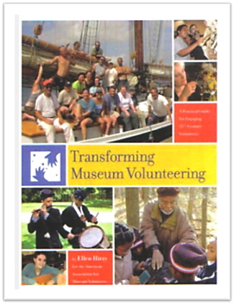
Transforming Museum Volunteering
By Ellen Hirzy
www.aamv.org

Slide 21
Twitter
@AAMers
@MuseumVols
#AAMVolunteers
Notes:
Join us on Twitter: @AAMers
#AAMinclusion
#AAMprofdev

Slide 22
Today’s Program
Explore how assessment processes are incorporated into the volunteer programs at three museums
Discuss how a related innovative strategy of peer coaching has recently been launched at one organization in an effort to emphasize reflective practice.
Notes:
Greg

Slide 23
Outcomes
Identify strategies to implement assessment protocols at your museum
Use new approaches for overcoming volunteer management hurdles
Practice new ways to change negative behaviors, and how this can be different among volunteer corps than it is for paid staff
Ask volunteers for their feedback as part of the evaluation process

Slide 24

Guiding Questions for Discussion
How do you measure success with volunteer programs?
How are the goals of volunteer programs different for the organization and the volunteers?
How do you engage volunteers to give valuable feedback about the volunteer program?
How do you continue to evaluate volunteers or train them over extended periods of time?
How do you discipline volunteers or talk to them about changing negative behaviors?
What is the best way to conduct mid-way though assessments for a volunteer program that has a defined beginning and end?

Slide 25
Audience Question
Is volunteer program evaluation a routine practice in your museum?
If “yes” – how do you use it to improve your program?
If “no” – what are the barriers to evaluation?

Slide 26

Why Evaluate Volunteers and
your Program?
Notes:
Greg

Slide 27
Richard Harker
President, AAMV
Education and Outreach Manager
Museum of History & Holocaust Education Kennesaw State University
Kennesaw, GA
rharker@kennesaw.edu
@rjwharker

Slide 28
Why Evaluate?
Convey appreciation and reinforce value of volunteers
Motivate volunteers
Allow museum to improve volunteer program
Flag problems early

Slide 29
For the Institution | Program Evaluation
Are we attracting enough volunteers with the right skills?
Is our volunteer program effective?
Are we retaining volunteers?
Are we providing the right conditions for our volunteers to succeed?
Are volunteers having the best possible experience with us?

Slide 30
Volunteer Program Evaluation
Constant and consistent formal and informal evaluations
Build evaluation into handbook, expectations, and orientation
Explain your motivations and methods and report back to volunteers
Be prepared to actively use the results and feedback

Slide 31
Evaluating Volunteers
Self-Evaluation
Individual evaluation sessions with supervisor
Ongoing evaluation
Informal feedback
The “exit interview”

Slide 32
Asking the Right Questions
“What did you expect from your volunteer experience? How has your actual experience compared?”
“How would you describe your volunteer experience to someone who was curious about volunteering at the museum?”
“What have you learned from your volunteer work? What else would you like to learn?”

Slide 33
Tips for Constructive Evaluation
Address behaviors and results, do not personalize
Do not divulge who gave what feedback
Balance positives and negatives
Mix improvement with celebration
Mix your evaluation of them, with their evaluation of you

Slide 34
Audience Questions & Comments
Notes:
Greg

Slide 35
Audience Question
Is the evaluation of individual volunteers a routine practice at your museum?
If “yes” how often:
Monthly
Every 3-4 months
Every 6 months
Once a year

Slide 36

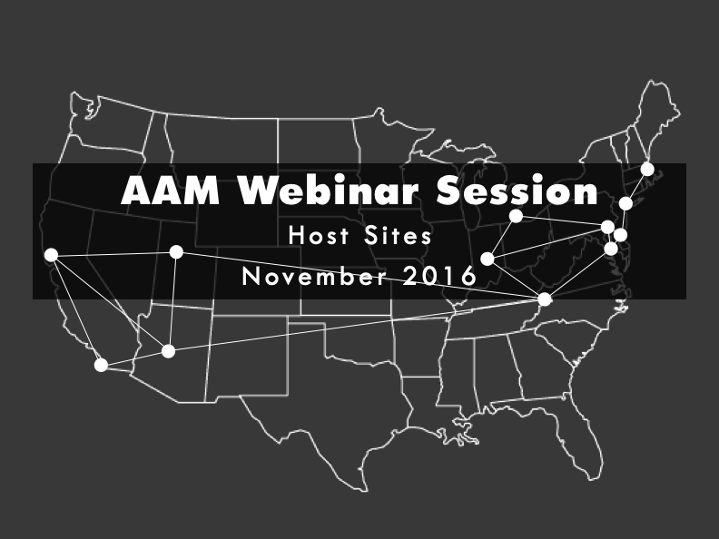

Evaluating Volunteers at
Philadelphia’s Magic
Gardens

Slide 37
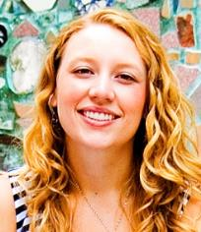
Olivia Edlund
Education and Outreach Manager
Philadelphia Magic Gardens
oedlund@phillymagicgardens.org

Slide 38
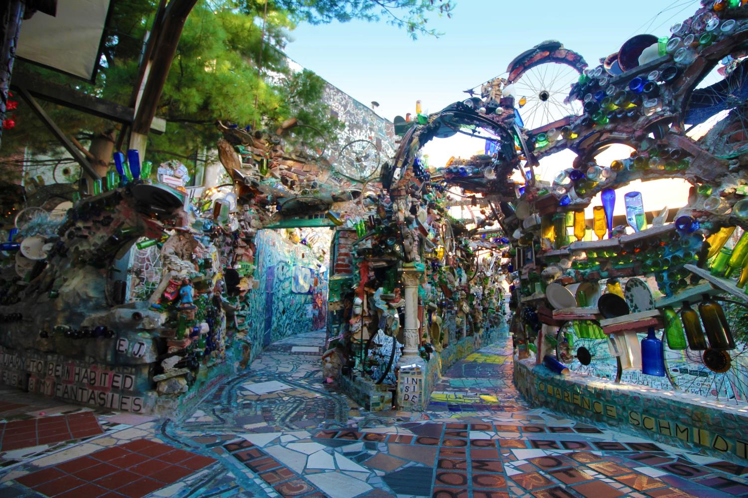

Slide 39

Opened as a museum in 2008,
volunteer program began in 2013
75% of visitors are millennials,
91% of volunteers are millennials,
95% of staff are millennials

Slide 40
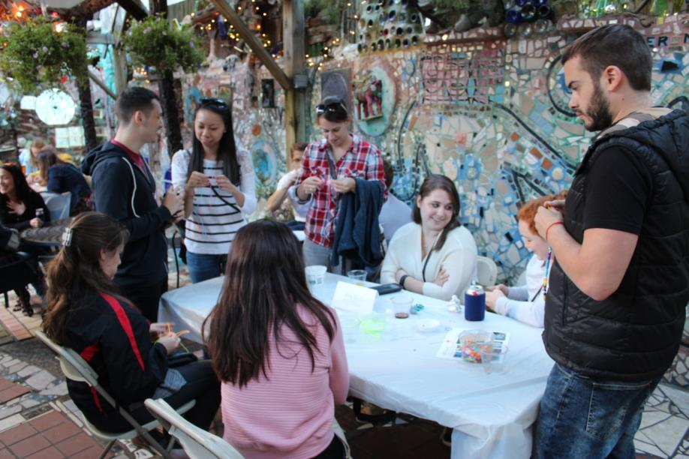
Evaluation Network
Volunteer Manager
Other staff
Visitors
Mostly informal
feedback

Slide 41
Negative Feedback
Based on volunteer policies (included in handout)
What is the most appropriate way of communicating with the volunteer?
What are the volunteer’s motivations for volunteering?
Retraining vs. discipline

Slide 42
Same scenario, different outcomes
Chronic lateness/absence from shifts
Email outlining behavior, suggested solution, recognizing their importance
Volunteers apologized and agreed to solution

Slide 43
Same scenario, different outcomes
Volunteers apologized and agreed to solution
Absent the following week
No more offenses
Received final warning, never responded
Reached highest level of volunteer achievement in 2016

Slide 44
Audience Questions & Comments
Notes:
Greg

Slide 45
Audience Question
Do you have clear policies about volunteer expectations, evaluation, performance improvement plans, disciplinary action, and dismissal?

Slide 46
Reflective Practice, Peer
Coaching, and The Chicago
History Museum Volunteer
Program
Notes:
Greg

Slide 47

Tina Nolan
Principal, Tina Nolan Consulting
tina@tinanolan.com
@TinaNolan
Marne Bariso
Volunteer and Intern Manager
Chicago History Museum
Bariso@chicagohistory.org

Slide 48

What is Reflective Practice?
The process of systemically thinking about the way you do your work, developing theories about how to improve upon the work, and enacting a plan to test your theory.
RP can be done individually, with a partner, or in a group.
Protocols for RP include peer-to-peer coaching, reflective journaling, and a host of other activities.

Slide 49
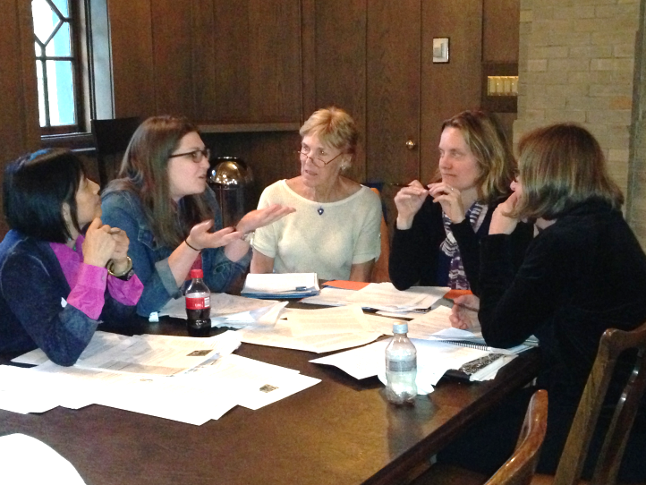
Evaluation or Reflective Practice?
Aims are the same
Goals are different
Approaches are different
Outcomes are different
Notes:
Aims: to ensure they highest quality experience is had by museum visitors
Goals:
Evaluation – to asses a volunteer’s capacity at meeting volunteer program expectations
Reflective Practice – to build capacity for deep thinking and action
Approaches:
Evaluation – directive, judgmental
Reflective Practice – can be directive, collaborative, or nondirective
Outcomes
Evaluation – keep the good ones, improve those who need improvement, weed-out poor performers
Reflective Practice – foster culture of learning and creativity. Not used as a measure to weed-out poor performers

Slide 50
Why Reflective Practice?
To encourage deep thinking about the process of formal or informal teaching
To foster a culture of learning and continuous improvement
To open dialogue and build a culture of trust
To encourage creativity and innovation
To improve the experience for the visitor

Slide 51
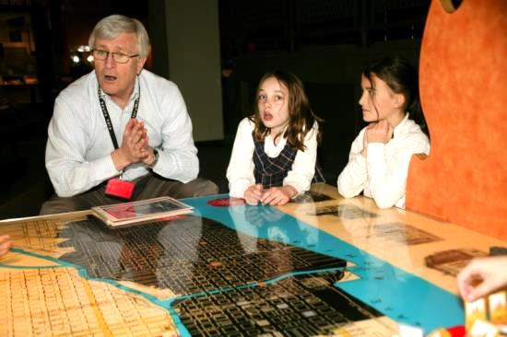
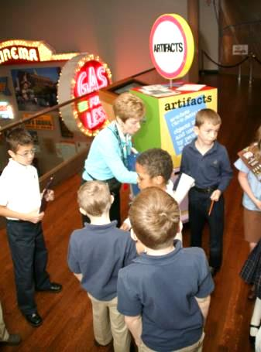
Chicago History Museum
Volunteer Gallery Interpreter Program
50+ volunteer gallery interpreters
  Lead exhibition tours and
  Staff experiential, hands-on activity carts
Activity Carts
  Field trips
  20 minute activities on topics such as the Great Chicago Fire, skyscrapers, movable bridges, “What is an artifact?”, and more
  Frequently, volunteer cart facilitators staff the carts in pairs.

Slide 52
Why Reflective Practice for the Chicago History Museum?
Standard form of evaluation didn’t work
We nearly began to investigate peer to peer evaluation when…
We learned about Tina Nolan’s work with peer coaching

Slide 53
Assumptions about Teaching & Learning
All people are capable of change, we learn throughout our lives, and we have a vast reservoir of untapped potential
Teaching cannot be reduced to a formula
A teacher’s observable practice is based on invisible thought processes
Skillful colleagues can enhance a teacher’s cognitive process

Slide 54
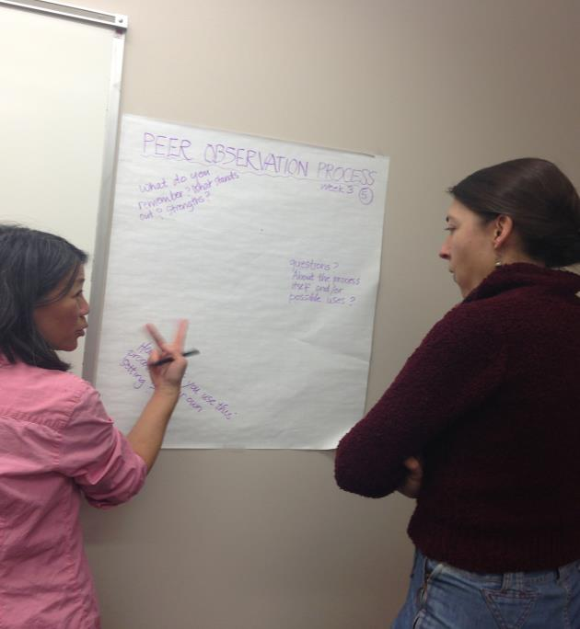
What is Peer ExchangeTM?
A reflective practice process through which two or more professional colleagues work together to:
  reflect on current practices
  expand, refine, and build new skills
  share ideas
  teach one another
  conduct research
  solve problems

Slide 55
Peer ExchangeTM Part One:
Peer Observations
Pre-Conference
Observation
Post-Conference
Action Planning
Notes:
The first half of the Peer Exhange^{tm} Process is a collaborative Peer Observation.
See the Peer ExchangeTM handout for more details.

Slide 56
INQUIRY CIRCLE FRAMEWORK: The Experiential Learning Cycle
Concrete Experience
Reflective Observation
Abstract Conceptualization
Active Experimentation
Notes:
The second half of the Peer Exchange^{tm} Process is the Inquiry Circle
Introduction
Reflective practice is important as it enables us to learn from our experiences of teaching and facilitating learning. Developing reflective practice means developing ways of reviewing our own teaching so that it becomes a routine and a process by which we might continuously develop.
David Kolb developed a theory of experiential learning that can give us a useful model by which to develop our practice. This is called The Kolb Cycle, The Learning Cycle or The Experiential Learning Cycle. The cycle comprises four different stages of learning from experience and can be entered at any point but all stages must be followed in sequence for successful learning to take place. The Learning Cycle suggests that it is not sufficient to have an experience in order to learn. It is necessary to reflect on the experience to make generalizations and formulate concepts which can then be applied to new situations. This learning must then be tested out in new situations. The learner must make the link between the theory and action by planning, acting out, reflecting and relating it back to the theory.
Concrete Experience (doing / having an experience)
The 'Concrete Experience' is the 'doing' component which derives from the content and process teaching
Reflective Observation (reviewing / reflecting on the experience)
The 'Reflective Observation' element stems from your analysis and judgments of events and the discussion about the learning and teaching that you engage in with your mentor and/or colleagues. People naturally reflect on their experiences of teaching, particularly when they are new to it and less confident in their abilities or when an experience has been painful. We've all come out of lectures saying to ourselves 'that went well or badly', in an intuitive sense. This might be termed 'common-sense reflection'. But how do we know it was good or bad and what was good or bad about it? We need to articulate our reflections in some systematic way so that we remember what we thought and build on that experience for next time.
For example this might be through your own self-reflections or evaluations after the event through keeping a log or journal. It may also include student feedback, peer observation of teaching (e.g. comments made by your mentor or colleague), moderation of assessments, external examiner comments, discussions with your mentor or a fellow participant. All of these can be brought together to give an overall reflection on your practice.
Reflection in itself, though, is insufficient to promote learning and professional development. Twenty years' experience may consist of twenty years teaching the same content in the same way! Unless we act on our reflections of ourselves and on the opinions of others then no development takes place.
Abstract Conceptualization (concluding / learning from the experience)
In order to plan what we would do differently next time, we need - in addition to our reflections on our experience - to be informed by educational theory e.g. through readings of relevant literature on teaching and learning or by attending staff development or other activities. Reflection is therefore a middle ground that brings together theories and the analysis of past action. It allows us to come to conclusions about our practice - 'Abstract Conceptualism'.
Active Experimentation (planning / trying out what you have learned)
The conclusions we formed from our 'Abstract Conceptualization' stage then form the basis by which we can plan changes - 'Active Experimentation'. 'Active Experimentation' then starts the cycle again when we implement those changes in our teaching practice to generate another concrete experience which is then followed by reflection and review to form conclusions about the effectiveness of those changes...
References
Kolb D.A. (1984) 'Experiential Learning experience as a source of learning and development', New Jersey: Prentice Hall
Boud D, Keogh R and Walker D (1985) 'Reflection: Turning Experience in to Learning', London: Kogan Page
Brockbank A and McGill I (1998) 'Facilitating Reflective Learning in Higher Education', Buckingham: SHRE/Open University Press
Cowan J (1998) 'On Becoming an Innovative University Teacher Reflection in Action', SRHE/OU
Moon J (1999a) 'Reflection in Learning and Professional Development Theory and Practice', London: Kogan Page
Schon D (1991) 'The Reflective Practitioner How Professionals Think in Action', London: Avebury

Slide 57
The Peer ExchangeTM Process:
PEER OBSERVATION & INQUIRY CIRCLE
Pre Conference
Observation
Post Conference
Reflective Writing
Inquiry Circle
Action Planning
Active Experimentation

Slide 58
Training CHM Volunteers on Peer Exchange
What Worked Well
  Getting ready in small group discussions
  Reflective practice is actually not new to our program
  Trainees helped shape the tools and materials.
    -Pilot Group, first
  We modeled parts of the Peer Exchange process.
    -Roleplay
    -Practicing using “language that promotes reflection”
  An over-arching theme to help shape the question
  Modeled reflection throughout the training

Slide 59
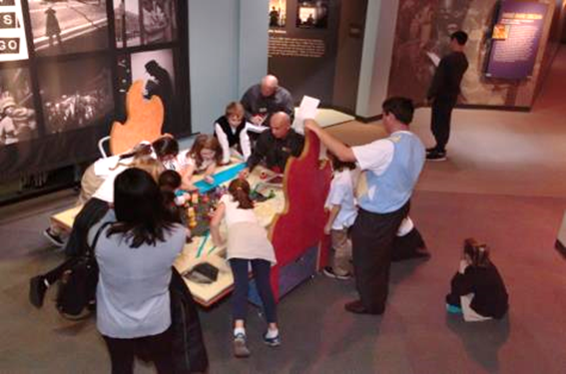
Training CHM Volunteers on Peer Exchange
Surprises
  Notable concerns about observing your peer (a.k.a. your friend)
  That it’s impossible to be a neutral observer

Slide 60
Implementation of Peer Exchange:
Trying it Out
Process
1. Found a partner
2. Identified a question about their practice
Observed one another
Shared notes with one another and planned
to attend…..
Inquiry Circle for group
discussion
Surprises
Confusion re. steps and purpose.
Some volunteers decided not to do it!
Some volunteers still waited until the last moment.

Slide 61
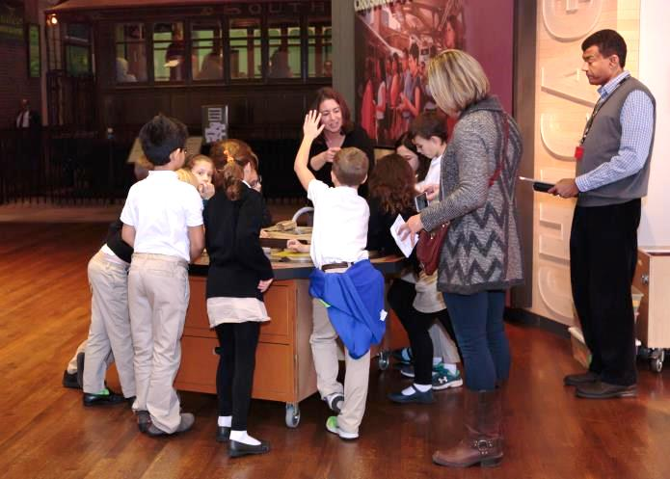
Benefits of Peer Exchange
Refining ability to think on your feet.
Ongoing reflection about personal skills
Improvement of skills
Innovative collaboration with peers

Slide 62
Moving Forward with Peer Exchange
Reflective practice will be embedded into materials henceforth
More examples and modeling during training
Activities that leads to meaningful questions—that the volunteers care about answering
“Behaviors that demonstrate”…

Slide 63
Audience Questions & Comments
Notes:
Greg

Slide 64

Colleague Conversations

Slide 65
Megan Millman,
Winterthur Museum, Garden and Library
Olivia Edlund
Philadelphia Magic Gardens
Tina Nolan
Principal, Tina Nolan Consulting
Marne Bariso
Chicago History Museum
Richard Harker
AAMV
Greg Stevens
AAM
Notes:
Greg

Slide 66
Guiding Questions for Discussion
How do you measure success with volunteer programs?
How are the goals of volunteer programs different for the organization and the volunteers?
How do you engage volunteers to give valuable feedback about the volunteer program?
How do you continue to evaluate volunteers or train them over extended periods of time?
How do you discipline volunteers or talk to them about changing negative behaviors?
What is the best way to conduct mid-way though assessments for a volunteer program that has a defined beginning and end?

Slide 67
Program Evaluation
Please provide your feedback about this program.
Evaluation link appears in the Chat box
Notes:
Greg

Slide 68
AAMV at AAM Annual Meeting
AAMV Networking Luncheon
Monday May 8, 11:45 a.m.-1:15 p.m.
$30.00 (registration required)
Risk Management and Volunteers: What Could Go Wrong?
Tuesday May 9, 8:45-10 a.m.
Internships for Small Museums
Monday May 8, 1:30 - 2:45 p.m.
It’s Critical: Evaluating Museum Volunteers
Tuesday May 9, 10:30-11:45 a.m.
http://annualmeeting.aam-us.org/schedule/
Notes:
Greg

Slide 69
AAM Recorded Webinar Library
Managing Multigenerational and Diverse Volunteers and Docents
Planning or Transforming Your Museum Volunteer Program Infrastructure
Recruiting, Selecting and Placing Museum Volunteers
Staffing and Managing Your Museum Volunteer Program
Supporting, Retaining and Recognizing Volunteers
Training Museum Volunteers
Working with College Students as Volunteers, Docents and Interns
aam-us.org/resources/online-programs/human-resources-webinars
Notes:
Greg

Slide 70
Your Host
Greg Stevens
Assistant Director, Professional Development
American Alliance of Museums
Arlington, VA
gstevens@aam-us.org
@DCGregStevens
Notes:
Greg

Slide 71

Champion Museums. Nurture Excellence.

