Slide 1

Internships for Small Museums
Monday May 8th, 2017
1:30 p.m. – 2:45 p.m.
In collaboration with:
www.aamv.org

Slide 2
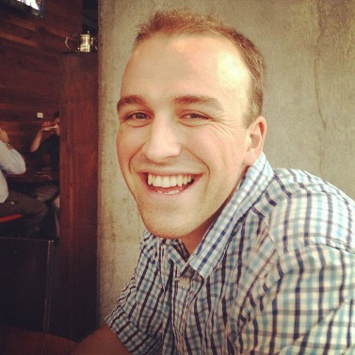
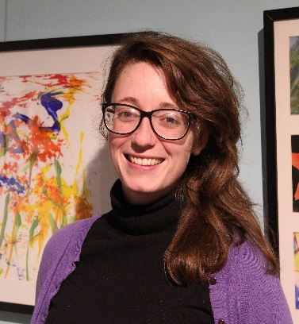
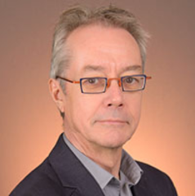
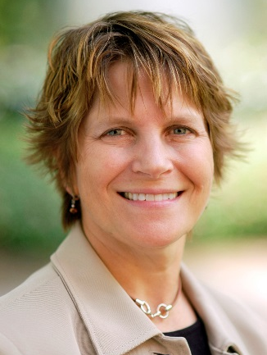
Richard Harker
Education & Outreach Manager, Museum of History and Holocaust Education, Kennesaw, GA
President, American Association for Museum Volunteers
Regina Lynch
Curator of Education Fellow
Biggs Museum of American Art, Dover, DE
Richard Toon
Research Professor, Director of Museums and Museum Studies, Arizona State University
Lin Nelson-Mayson
Director, Goldstein Museum of Design
Director of Graduate Studies, Museum Studies minor
University of Minnesota

Slide 3
Internships for Small Museums
Session structure:
Volunteers versus Interns
Recruitment
Ethics
Best and Worst Practices
Audience Conversation and Q&A

