Slide 1
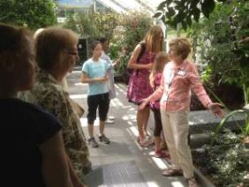
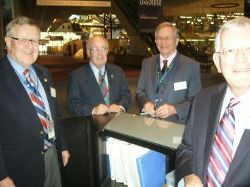
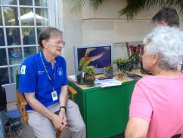
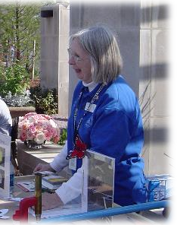
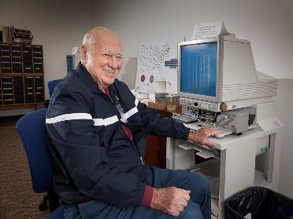
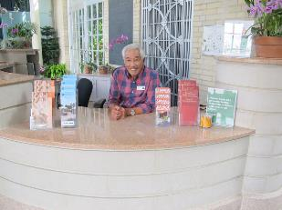
Embracing and Harnessing the Power of Older Adult and Retiree Volunteers
Maura Nelson, Steve Ruff, Mike Taylor,
Marjorie Abbot, Mark Jones

Slide 2
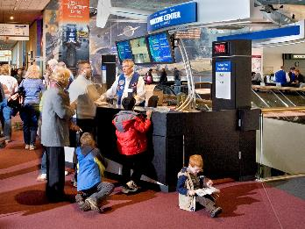
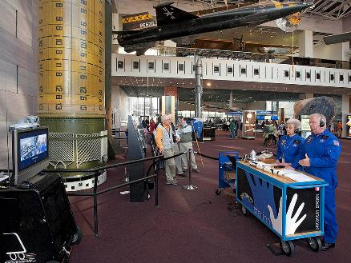
Advanced Organizer
Introductions
National Volunteerism
Trends and Highlights
Museum Profiles
Volunteer Spotlights
Hands-on Activity
Gentle Reminders
Questions/Contacts

Slide 3
National Volunteerism
About 62.8 million Americans, or 25.3 percent of the adult population, gave 7.9 billion hours of volunteer service worth $184 billion in 2014.
“Silent/Mature” Generation (75 and older) had the highest median hours among volunteers at 100.
  Corporation for National and Community Service: National Data Volunteering and Civic Engagement in the United States (2014).

Slide 4
Trends and Highlights Overview
Baby Boomers (45-64 years)
Older Adults (65 and older)
27.2% of baby boomers volunteer
19.9 million volunteers
2.8 billion hours of service
$63.9 billion of service contributed
52 median hours
24.0% of older adults volunteer
10.7 million volunteers
2.0 billion hours of service
$45.7 billion of service contributed
90 median hours

Slide 5
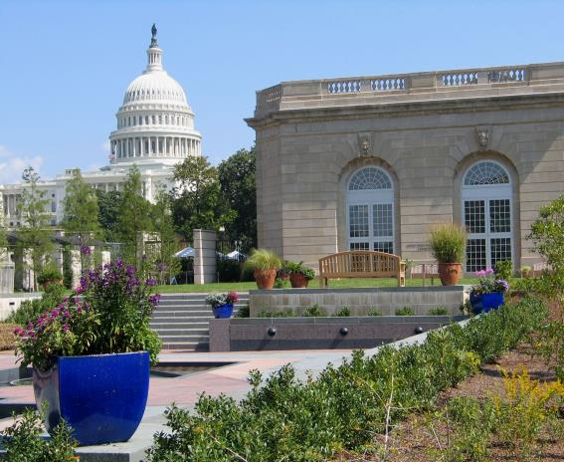
United States Botanic Garden
Established by the U.S. Congress in 1820, the U.S. Botanic Garden is one of the oldest botanic gardens in North America.
Located at the base of the Capitol in Washington, D.C.
Welcomes over 1 million visitors annually
AAM Accreditation

Slide 6
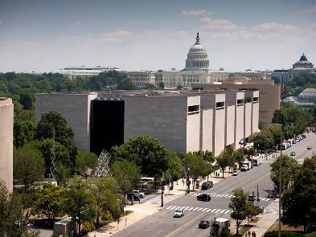
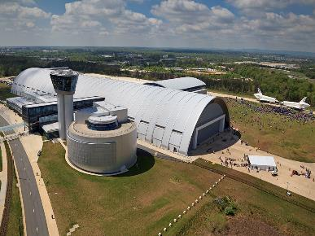
Smithsonian National Air and Space Museum
National Mall Building and Steven F. Udvar-Hazy Center
The Smithsonian's aeronautical collection began in 1876 when a group of kites was acquired from the Chinese Imperial Commission.
The National Air and Space Museum is the largest of 19 museums included in the Smithsonian Institution.
More than nine million people visit the Museum’s two locations annually, making it the most visited museum in the country.
AAM Accreditation

Slide 7
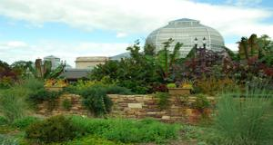
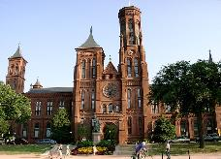
Volunteer Program Information
U. S. Botanic Garden
Smithsonian Institution
~ 160 volunteers
  ~42% >62 years
  ~62% >50 years
Volunteer roles:
  Horticulture (gardening aids, behind-the scenes collection care, plant health scouts)
  Public Engagement (docents, visitor services, discovery carts, educational programming)
~6,300 SI volunteers
~ 1,000 volunteers at NASM
  ~93% of the 300+ docents (tour guides) are >55 years
Volunteer roles:
  Public engagement (docents, visitor services, discovery stations, educational programming)
  Behind-the-scenes (research, archivists, conservation, collections care)

Slide 8
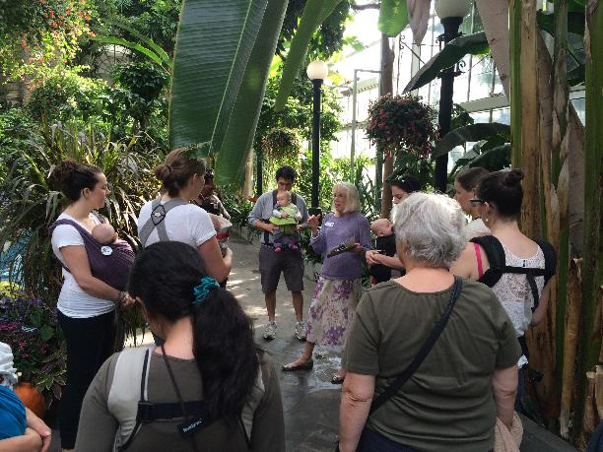
Marjorie Abbot, USBG
Why volunteer?
Looking for a new avocation which combined interest in plants, love of travel, and photography.
Why the Garden?
Volunteering at the USBG has and continues to be very satisfying because of my contact with people of all ages and my on-going botanical learning.

Slide 9
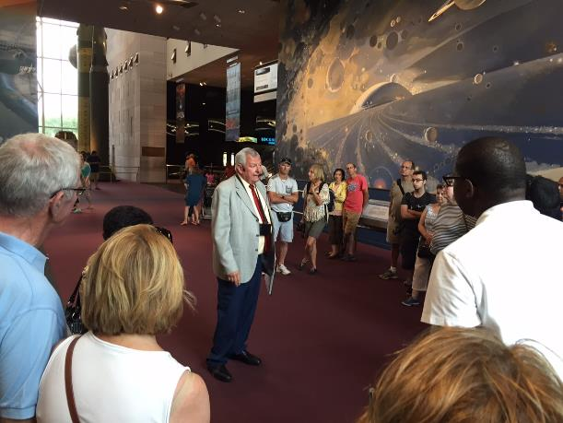
Mark Jones, NASM
Why volunteer?
I thoroughly enjoy giving tours. Working together with other Docents and the Staff is equally rewarding.
Why NASM?
The common thread, for all of us is our love of aviation and space.

Slide 10
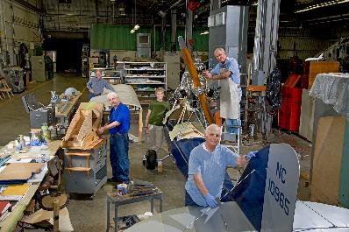
Volunteer-Centered Museum Experience:
Accessibility, Advocacy and Accountability
Accessibility: Develop and implement effective strategies that empower volunteers to experience museums more fully.
Advocacy: Excel as advocates for the volunteers within the museum.
Accountability: Promote the nurturing of an enlightened citizenry.
Translation: The three C’s
  Comfort
  Confidence
  Choice

Slide 11
Gentle Reminders
Retention
Concerns
Valued/Respected
Continuing Education
  Access to staff expertise
Community/Social Engagement
Alternative Positions and/or “Emeritus” status
Technology training
  Computers, Audio-visual equipment, Multi-media applications, etc.
Prioritize Safety
  Mobility
    Walking/Trips/Falls
  Cognitive Ability (Dementia/Alzheimer’s Disease)
  Document Emergency Contacts

Slide 12
Contacts
U.S. Botanic Garden
Smithsonian
Air and Space Museum
Maura Nelson
  Program Specialist & Volunteer Coordinator
  mnelson@aoc.gov
Steve Ruff
  Docent Program Coordinator, Chantilly, VA
  ruffs@si.edu
Mike Taylor
  Docent Program Coordinator, Washington, DC
  taylorma@si.edu

